Slide 1
CCNA (200-125)
WAN Protocols
Instructor:
Muhammad Naeem
(MSIT/RHCE/CCNP/CCNA/MCSE)
Cell: 0345-5238281
E-Mail: mna571@yahoo.com

Slide 2
Objectives:
Leased Lines
WAN Protocols
HDLC
PPP

Slide 3
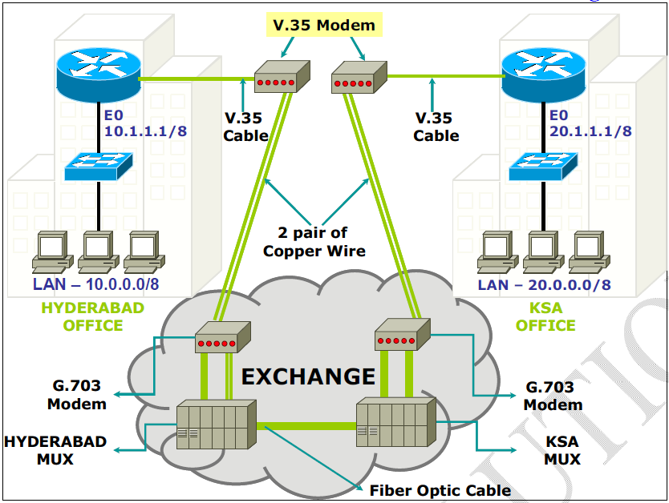
Example of Leased Line

Slide 4
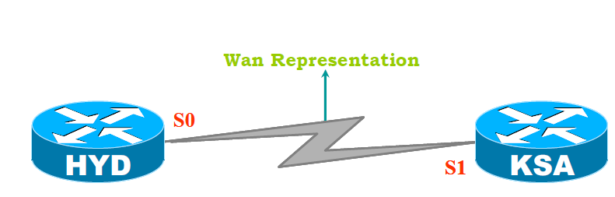
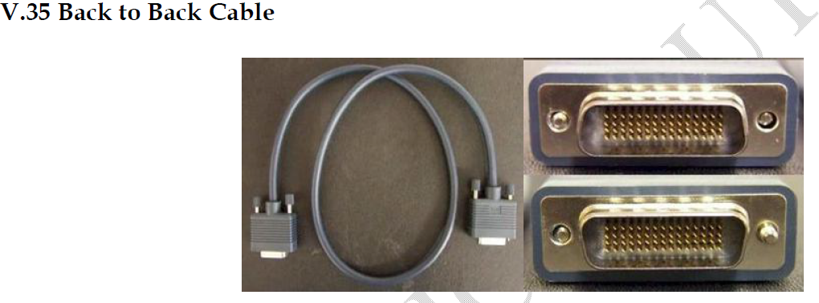
A Back to Back Cable is used which emulates the copper wire, modems and MUX, the
complete exchange setup.
Without DCE & DTE device communication is not possible.

Slide 5
WAN Interfaces
Router # show controllers (s0/0 or s0/1)
(To know whether the cable connected to the serial interface is DCE or DTE)

Slide 6
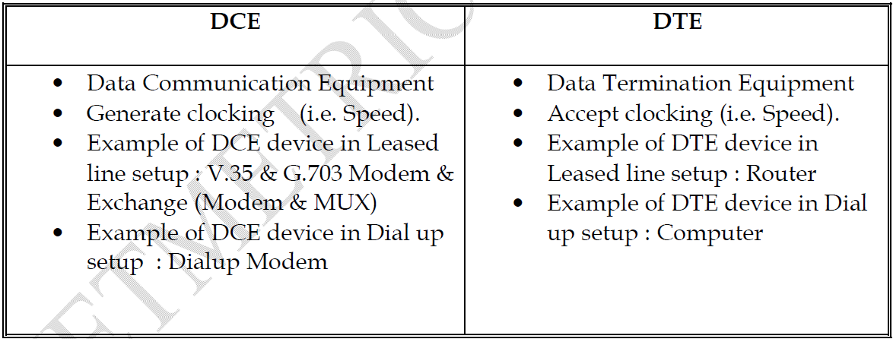
DCE vs. DTE
Leased line Modem also called as CSU/DSU (Channel Service Unit and Data Service Unit). It
acts as a DCE device which generates clock rate.

Slide 7
WAN Protocols
Leased Lines uses two types of WAN encapsulation protocols:
High Data Link Protocol (HDLC)
Point to Point Protocol (PPP)

Slide 8
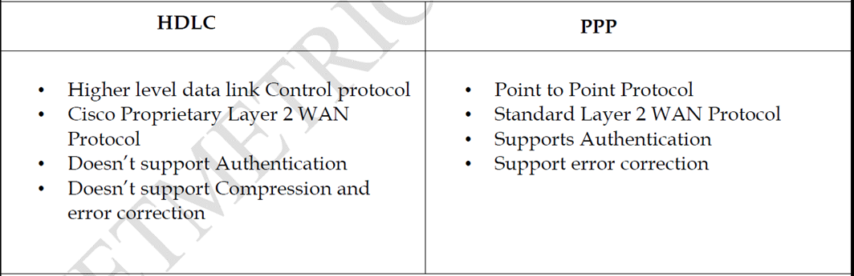
WAN Protocols

Slide 9
PPP supports two authentication protocols:
PAP (Password Authentication Protocol)
CHAP (Challenge Handshake Authentication Protocol)
PAP (Password Authentication Protocol)
PAP provides a simple method for a remote node to establish its identity using a two way handshake.
PAP is done only upon initial link establishment
PAP is not a strong authentication protocol.
Passwords are sent across the link in clear text.

Slide 10
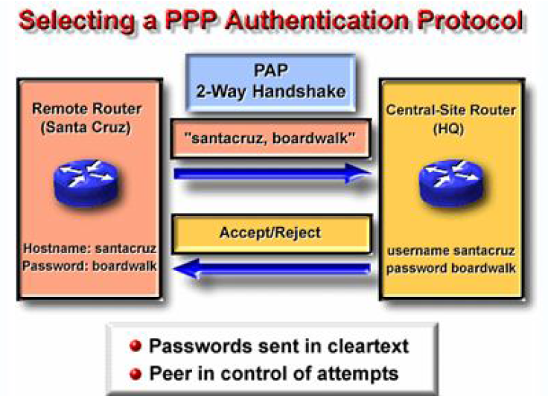

Slide 11
CHAP (Challenge Handshake Authentication Protocol)
After the PPP link establishment phase is complete, the local router sends a unique “challenge” message to the remote node.
The remote node responds with a value (MD5)
The local router checks the response against its own calculation of the expected hash value.
If the values match, the authentication is acknowledged. Otherwise, the connection is terminated immediately.

Slide 12
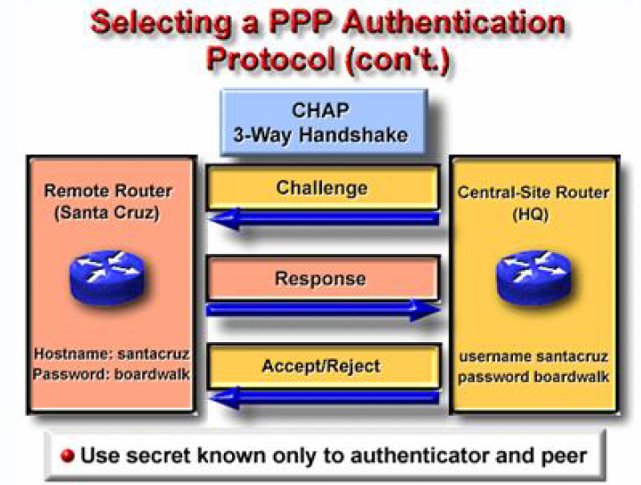

Slide 13
Configuration of HDLC & PPP
Configuration of HDLC:-
Router(config)# interface serial 0/0
Router(config-if)# encapsulation hdlc
Configuration of PPP:
Router# configure terminal
Router(config)# interface serial 0/0
Router(config-if)# encapsulation ppp

Slide 14
Configuring PPP Authentication
Enable CHAP Authentication on Router1
R1(config)# username R2<next router’s name> password cisco
R1(config)# interface serial 0/0
R1(config-if)# encapsulation ppp
R1(config-if)# ppp authentication chap
Enable PAP Authentication on Router1:-
R1(config)# username R2<next router’s name> password cisco
R1(config)# interface serial 0/0
R1(config-if)# encapsulation ppp
R1(config-if)# ppp authentication pap

Slide 15
Configuring PPP Authentication
Enable CHAP Authentication on Router2
R2(config)# username R1<next router’s name> password cisco
R2(config)# interface serial 0/0
R2(config-if)# encapsulation ppp
R2(config-if)# ppp authentication chap
Enable PAP Authentication Router2:-
R2(config)# username R1<next router’s name> password cisco
R2(config)# interface serial 0/0
R2(config-if)# encapsulation ppp
R2(config-if)# ppp authentication pap

Slide 16
Troubleshooting commands:
Router # show ip interface Brief
1) Serial is up, line protocol is up (connectivity is fine)
2) Serial is administratively down, line protocol is down
(No Shutdown has to be given on the local router serial interface)
3) Serial is up, line protocol is down
(Encapsulation mismatch or clock rate has to be given on dce)
4) Serial is down, line protocol is down
(Serial interface on the remote router has to be configured)

